Slide 1

G2M Case Study
Exploratory Data Analysis
Virtual Internship
1-Aug-2021

Slide 2

Agenda
Executive Summary
Problem Statement
Approach
EDA
EDA Summary
Recommendations

Slide 3
Description:
XYZ is a private equity firm in US. Due to remarkable growth in the Cab Industry in last few years and multiple key players in the market, it is planning for an investment in Cab industry.
Provide actionable insights to help XYZ firm in identifying the right company for making investment.
Cab Companies:
Yellow Cab
Pink Cab

Slide 4
Data Preparation:
There are 4 datasets:
Cab_Data.csv – this file includes details of transaction for 2 cab companies.
Customer_ID.csv – this is a mapping table that contains a unique identifier which links the customer’s demographic details.
Transaction_ID.csv – this is a mapping table that contains transaction to customer mapping and payment mode.
City.csv – this file contains list of US cities, their population and number of cab users.

Slide 5
EXPLORATORY
DATA
ANALYSIS

Slide 6
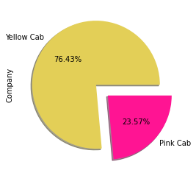
Information on Cab Company
Market share of Yellow cab company is much grater than pink

Slide 7
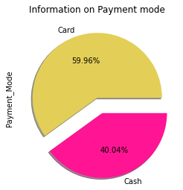
Information on Cab Company
Customers prefer card over cash.

Slide 8
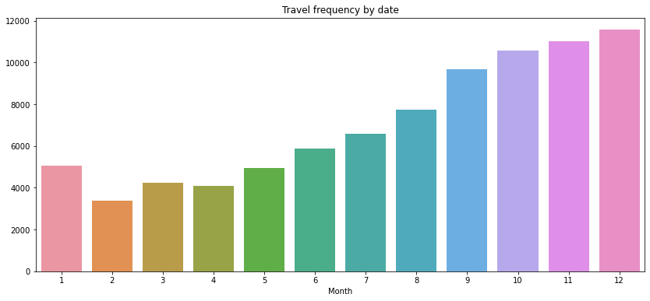
Travel Frequency per Month:

Slide 9
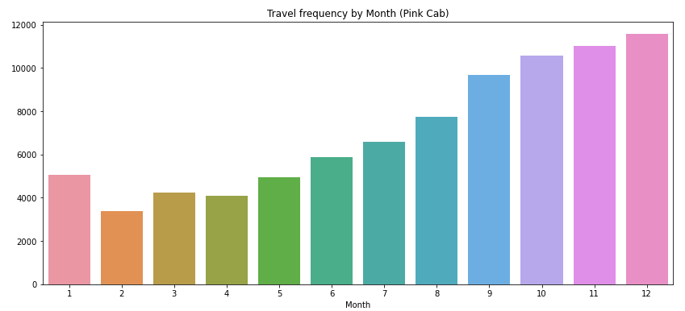
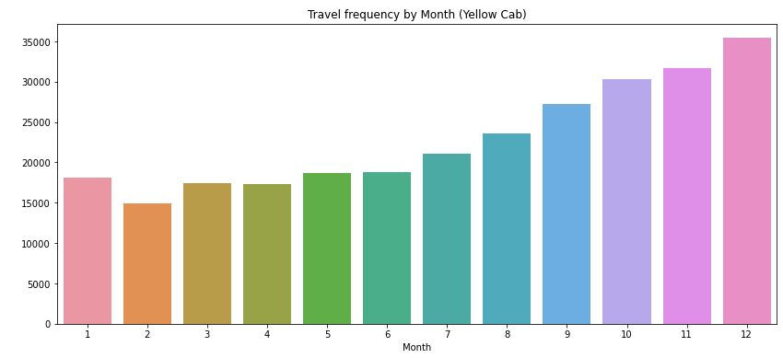
Travel Frequency per Month:
Yellow Cab has higher travels (35000) in the month of December which is the holiday season compared to Pink Cab (11000).

Slide 10
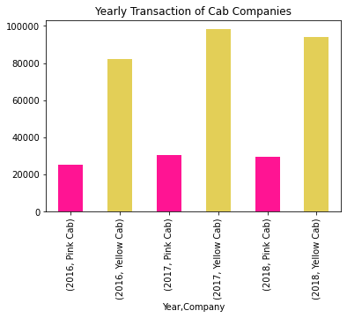
Transaction per Year for both Cabs:
From the graph it shows that on yearly basis no. of transactions for Yellow cab is higher than Pink cab.

Slide 11
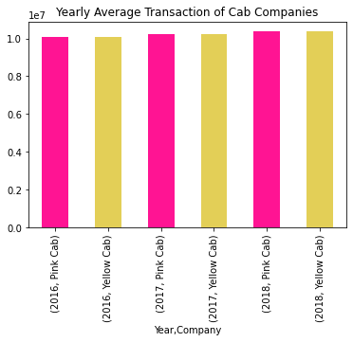
Average Transaction per Year for both Cabs:
From the graph it shows that yearly basis no. of average number transactions for Yellow cab and Pink cab are the same

Slide 12
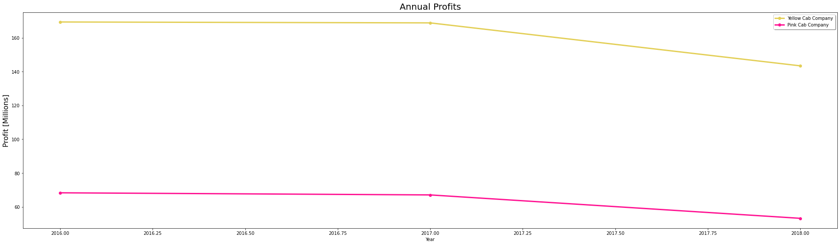
Average Annual Profit Year wise:
From the graph it shows that yearly basis Average profit of yellow cab is more than pink cab.

Slide 13
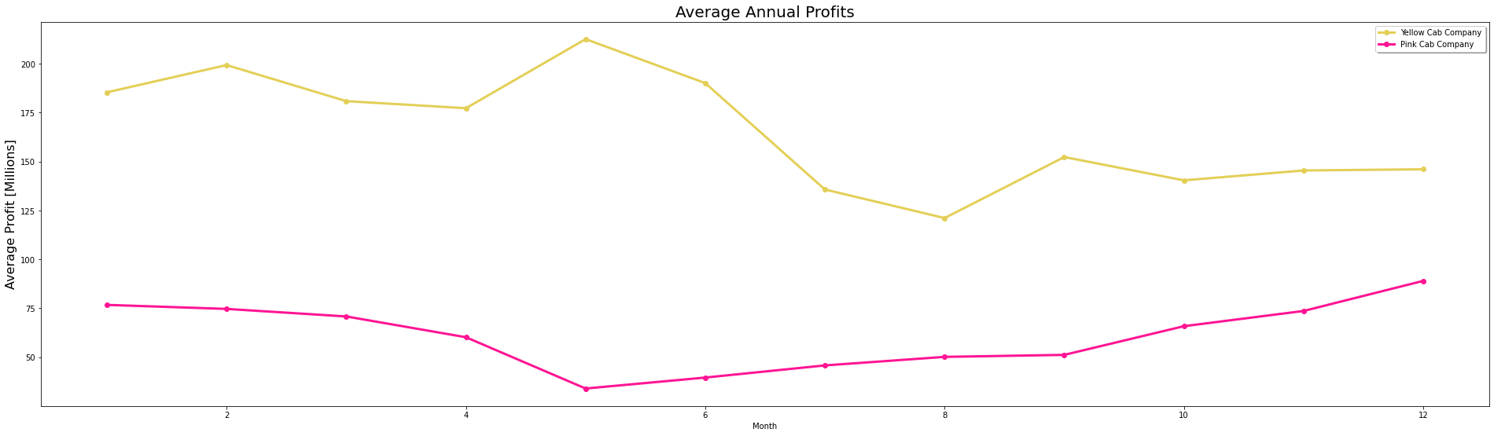
Average Annual Month wise:
From the graph it shows that month wise Average profit of yellow cab is more than pink cab.

Slide 14
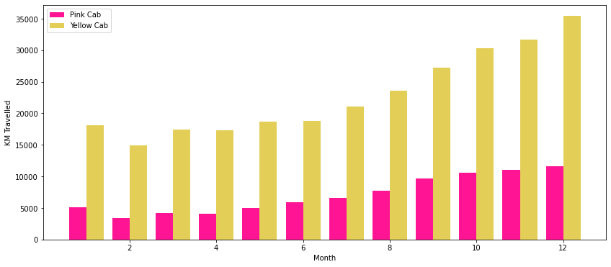
KM travelled by both the companies:
From the graph it shows that month wise yellow cab company has travelled than pink cab company

Slide 15
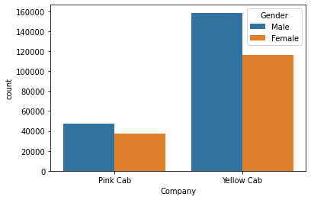
Number of customers gender wise
From the graph it shows that gender wise yellow cab company and pink cab company both have more male customers.

Slide 16
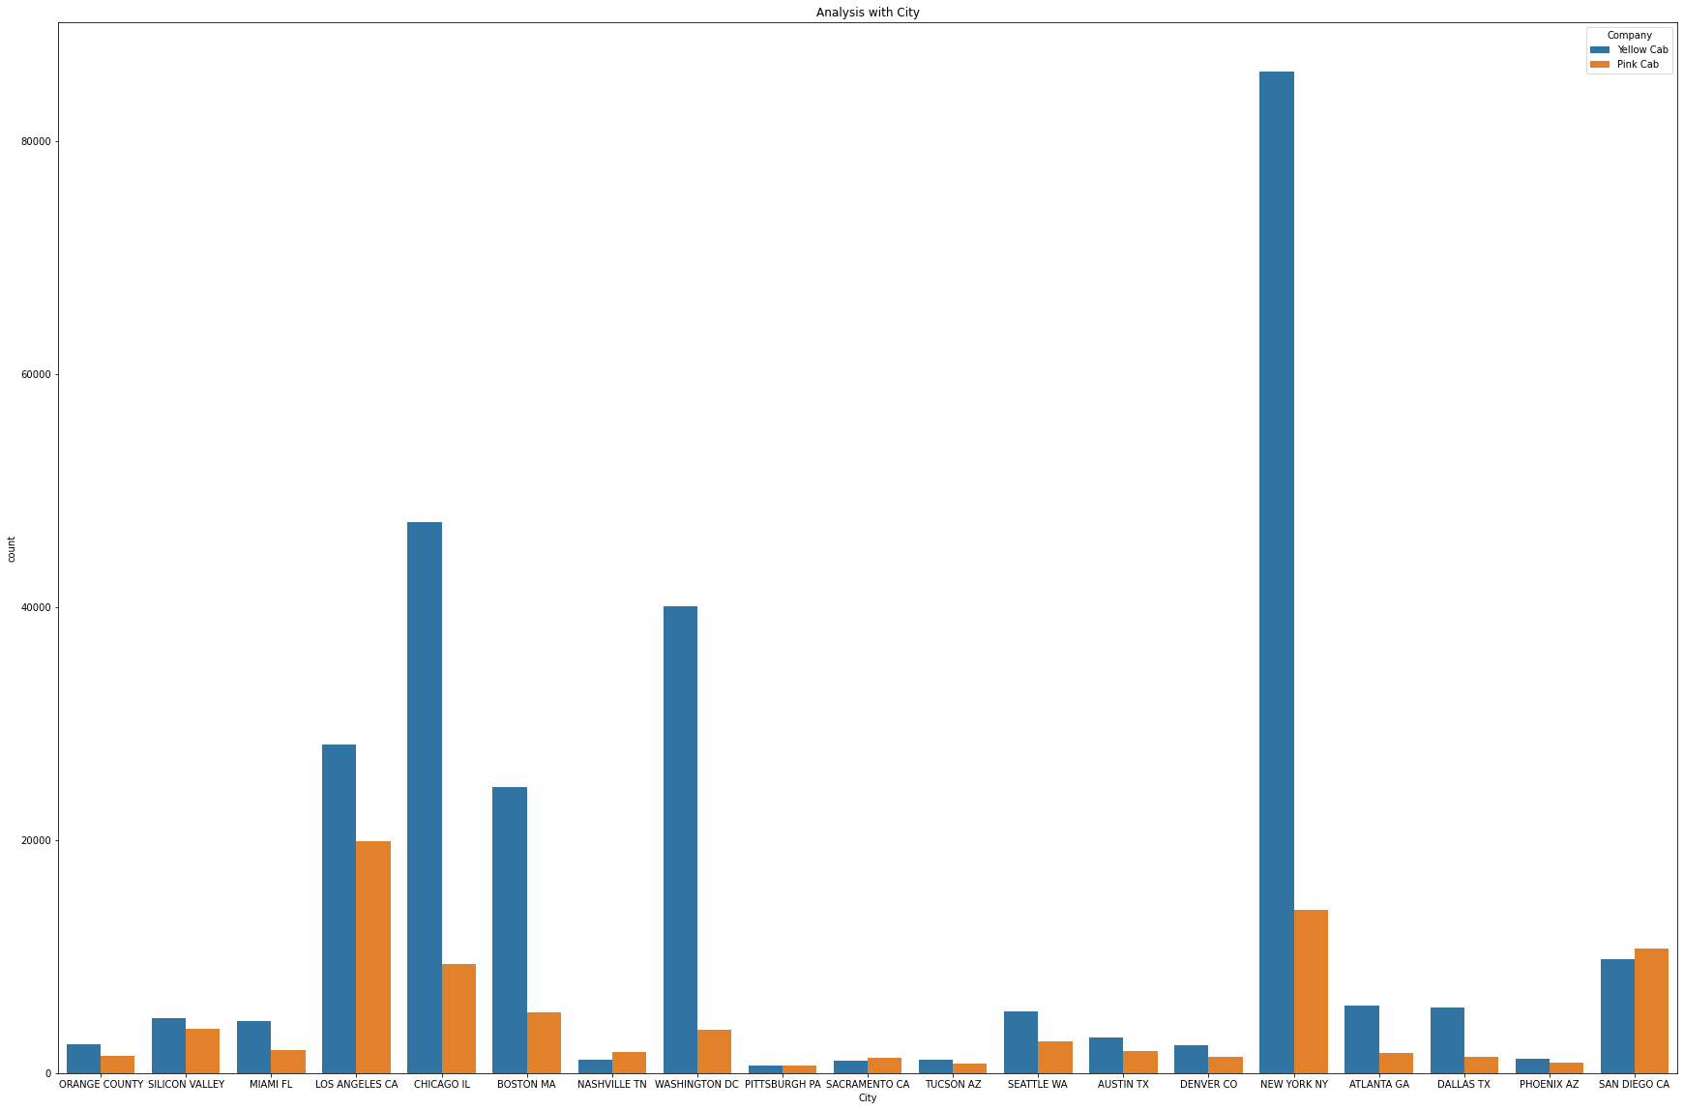
Cab Users per City:
In NEW YORK there are more yellow cabs and in SAN DIEGO there are more pink cabs buts this is not affected by city population

Slide 17
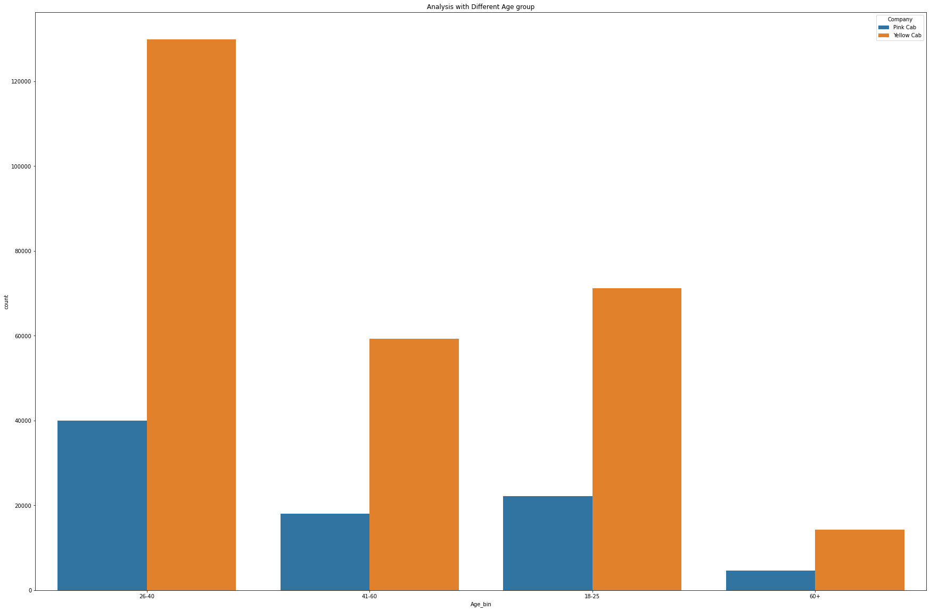
Analysis with Different Age group:
People Age from 26-40 take more Cabs and in all the groups yellow taxi is preferred more

Slide 18
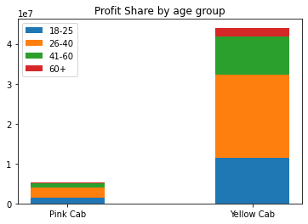
Analysis of profit with Different Age group:
26-40 age group gives the maximum profit to cab companies

Slide 19
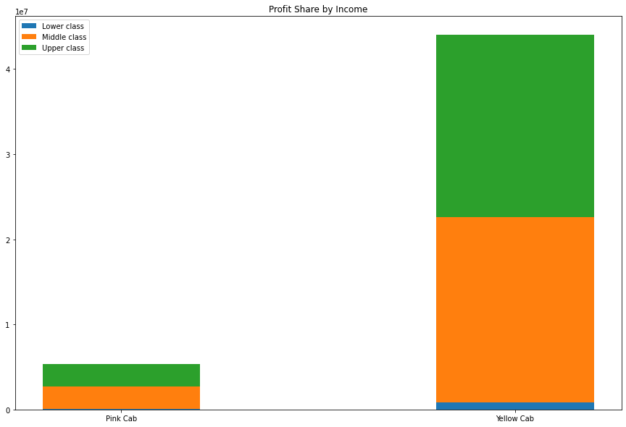
Profit share by class
Upper class and Middle class contributes more in the profits

Slide 20
Recommendations
Market share: There is a huge difference between market share of both the companies there are much more yellow cabs than pink hence they will be able to serve customer better.
Customer Reach: Yellow cab has higher customer reach in 15 cities while Pink cab has higher customer reach in 4 cities. We have also observed that Yellow cab is doing good in covering other cab users as compared to Pink cab.
Customer Retention: Travelle frequency goes down in non-festive seasons but it can be seen more in pink cab company.
Profit: Yellow cab company have higher market share than pink but the average profit of yellow cab company is much higher than pink so yellow cab company is doing better than pink.
After considering above points our recommendation would be to go for the Yellow Cab Company.

Slide 21
Thank You

